Slide 1


Slide 2
Our Mission
Ignite Christian Leaders worldwide to lead others to participate in the life of the Trinity by breaking down barriers prohibiting a growing healthy relationship with God the Father.

Slide 3
Our Mission
Through
Discipleship & Evangelism

Slide 4
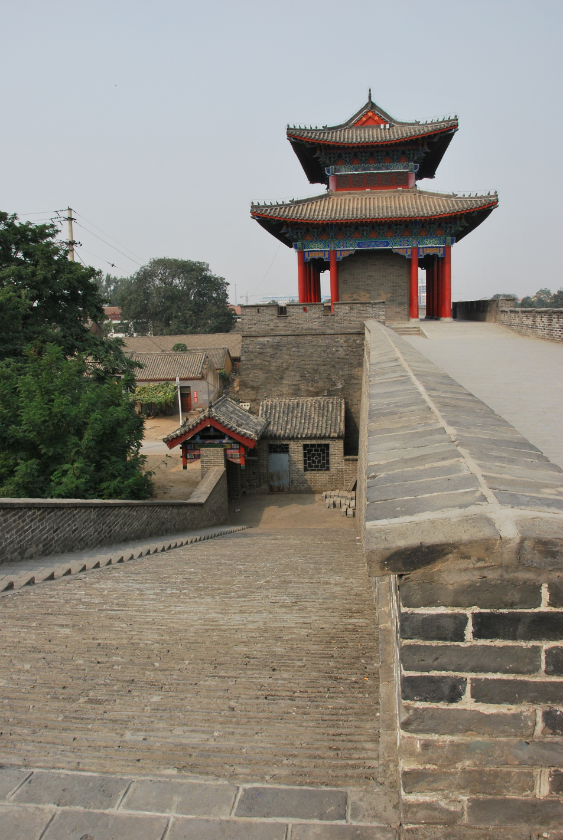
Becoming What God Intended
University Training , Beijing
Trinity seminar to Catholic Nuns, Daming
Sept 2013

Slide 5
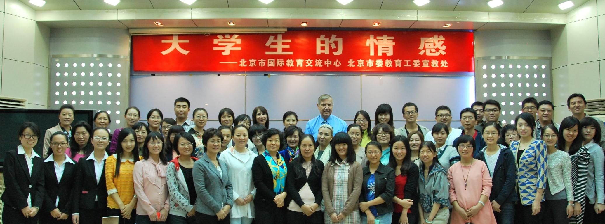
Dr. Eckman & Cathy at the University of Posts and Communications, Beijing.
60 counselors and student helpers attended the course on
“Emotional Development of University students”

Slide 6
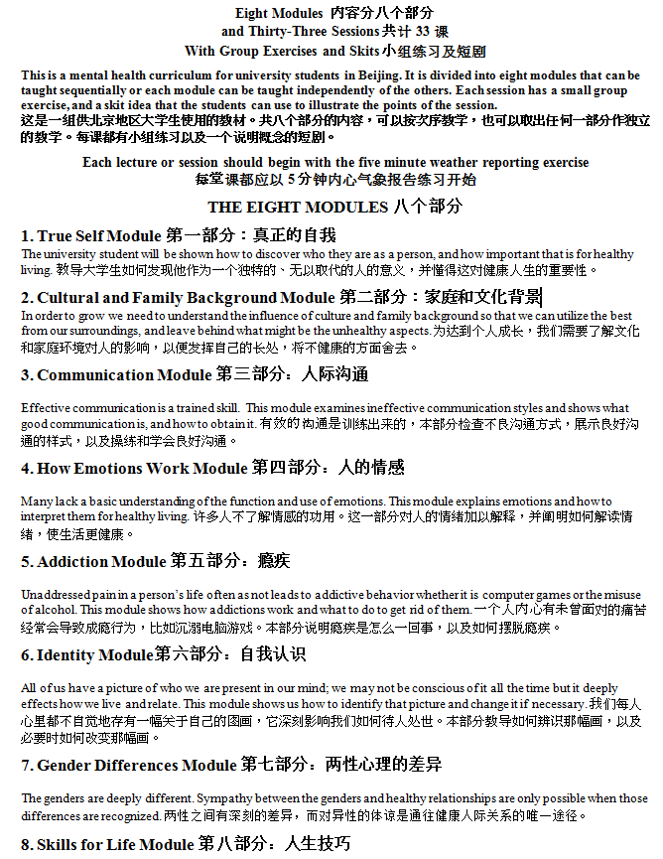
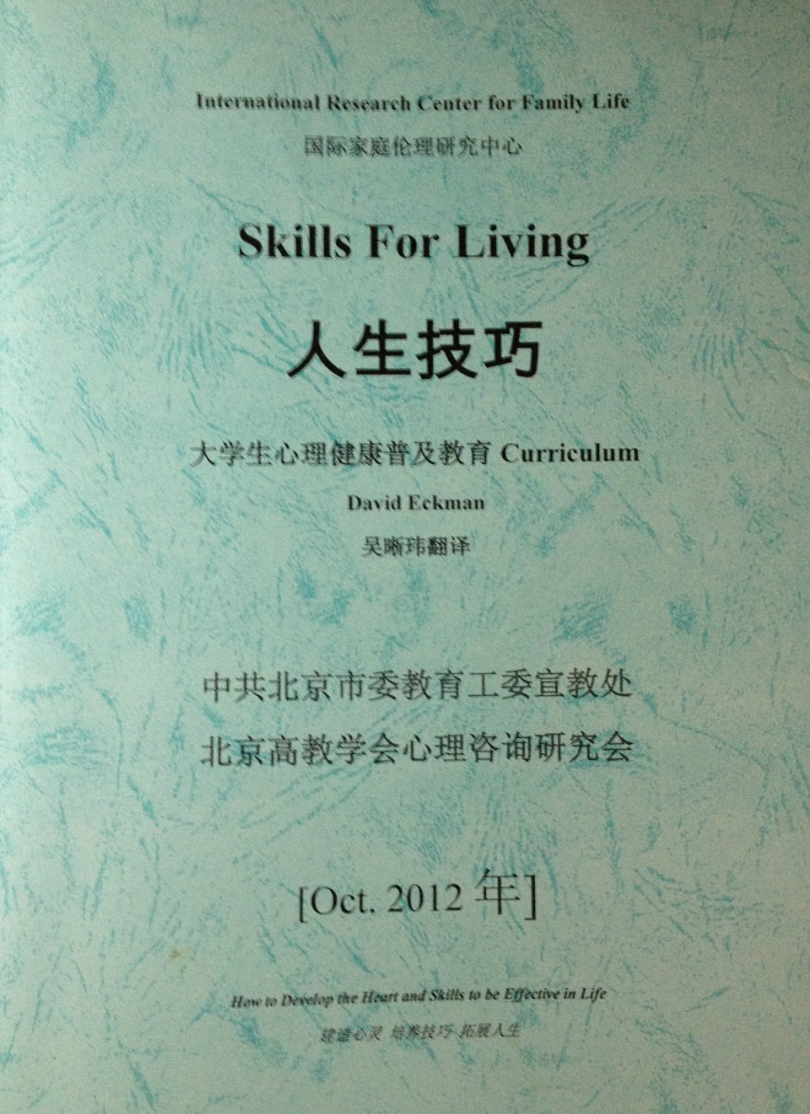
Skills For Living Workbook & List of Modules

Slide 7
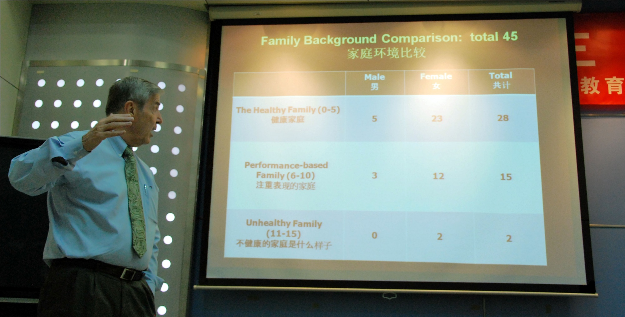
Unusual and revealing results of the Family Background Questionnaire Testing for
60 counselors & student helpers

Slide 8
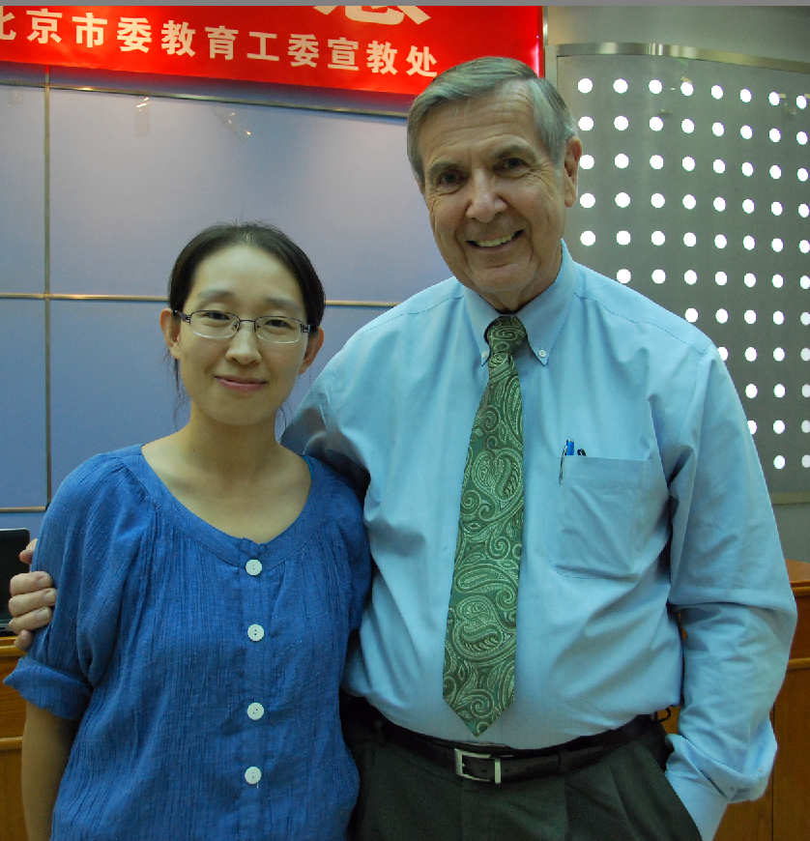
Letter of Recommendation by Dr. Xu:
Dr.Eckman’s Skills for living curriculum is a perfect educational module for the university students in China.
…”Part 1, 2, 6 and 7 focus on family background and identity which will help the students to know themselves better as special individuals, and how their original families dye different colors on their pictures of themselves.
Chinese students may do very well on examinations, but they would be unhappy. Some of them are trapped in depression and cannot find a way out.
…”Part 3, 4, 5 and 8 of this curriculum will help them to learn useful skills to cope with pressures, manage emotions and build healthy relationships with each other.
The unique advantage of this curriculum is the group exercise. This kind of modular training will help students communicate with each other and encourage self-growth.
It is my great privilege to have Dr. Eckman’s consent to use Skills For Living as a textbook in my class. I will introduce this curriculum into Peking University Health Science Center as an optional course of undergraduates. I will try my best to make the best use of it and promise to send feedback from my class.”
Dr. Sofia Xu
Ph.D. Clinical Psychologist
Medical Psychology Institute,
Peking University Health Science Center
Dr. Eckman & Dr. Xu, Clinical Psychologist at Peking Univ. one of the most prestigious schools in China. She has an M.S. and Ph.D in Clinical Psychology and has written 10 publications. She is all of 30 years old.

Slide 9
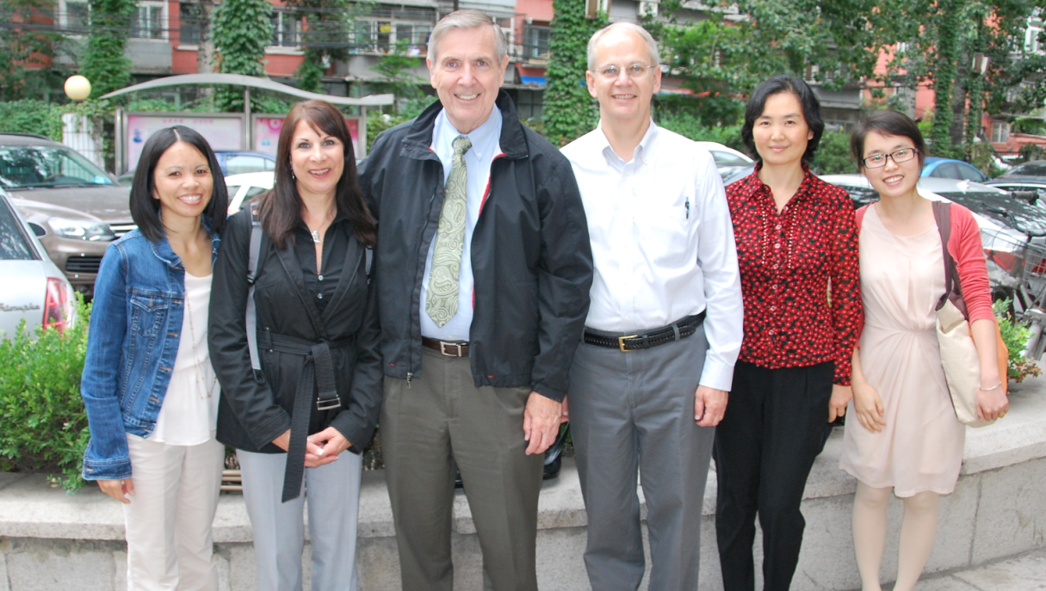
Gayle, Cathy, Dr. Eckman, well known missionary in China,
Karen & Anya-volunteer translators.

Slide 10
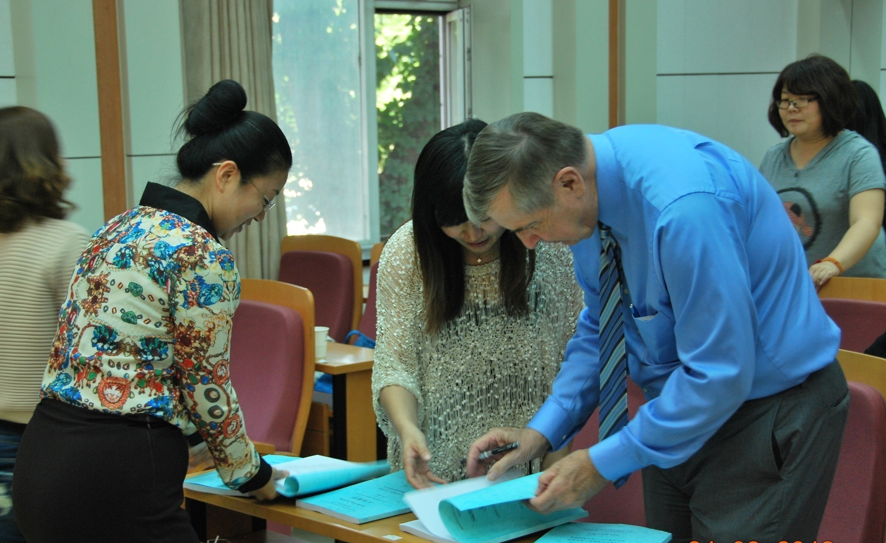
Dr. Eckman autographing the Skills For Living Workbook.
BWGI had 100 copies made for the counselors & student helpers to give to their co-workers. They took all 100!

Slide 11
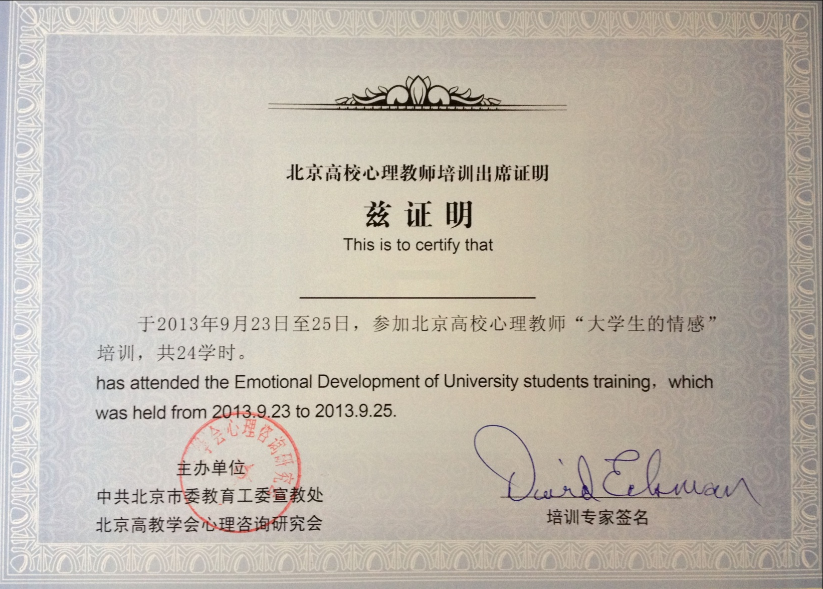
Stamped Certificate from the University of Posts & Communication given to each attendee

Slide 12
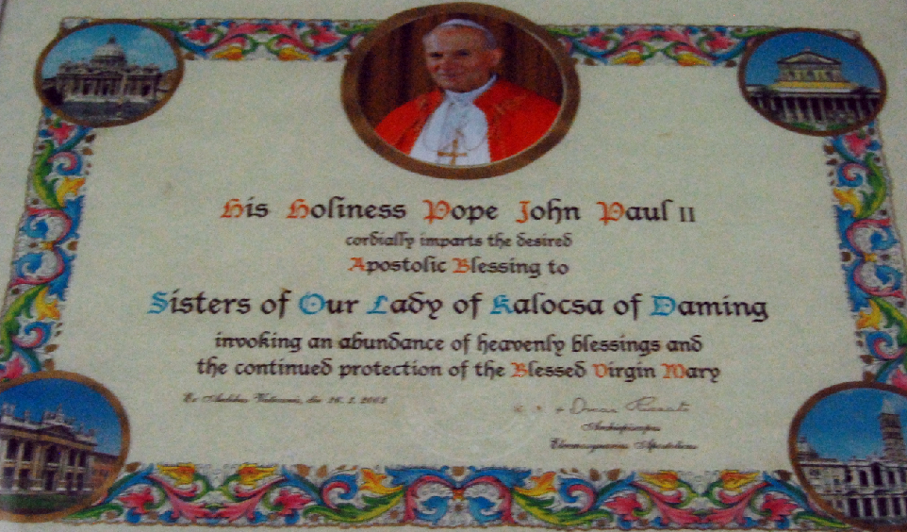
Plaque from Pope John Paul II at the convent in Daming

Slide 13
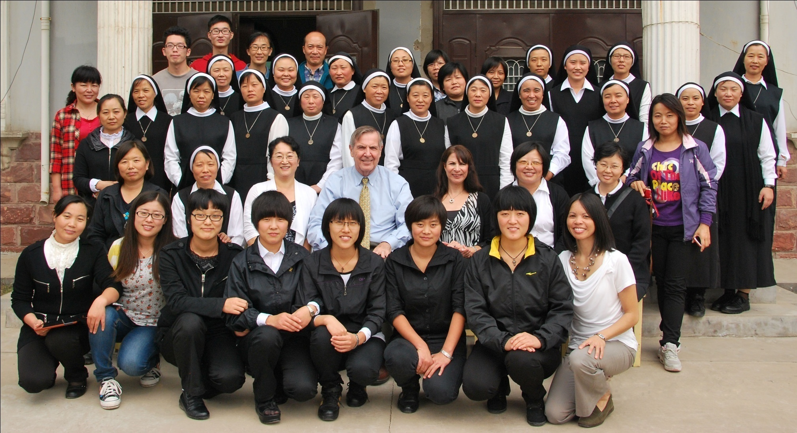
Sr. Savier Wong (two left from Dr. Eckman) Jijian (left of Dr. Eckman), longtime friend and translator for BWGI, Sr. Johanna (two from right of Dr. Eckman)

Slide 14
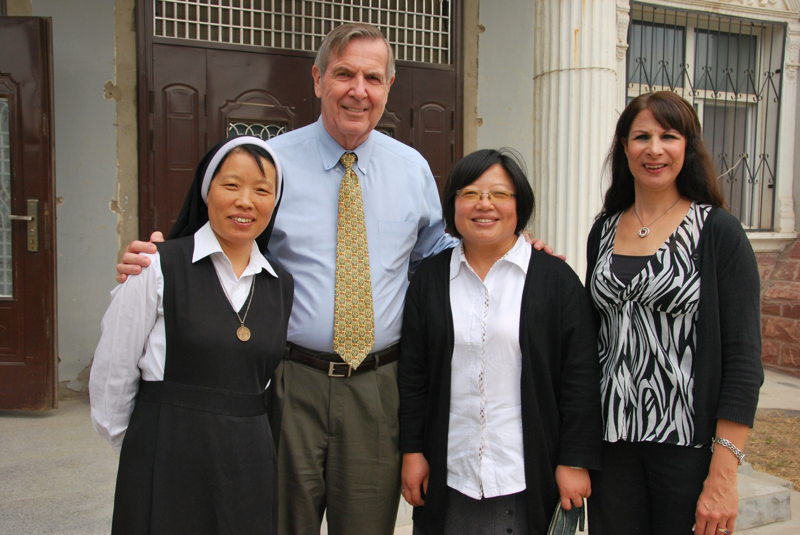
Sr. Wong, Dr. Eckman, Sr. Johanna, Cathy

Slide 15
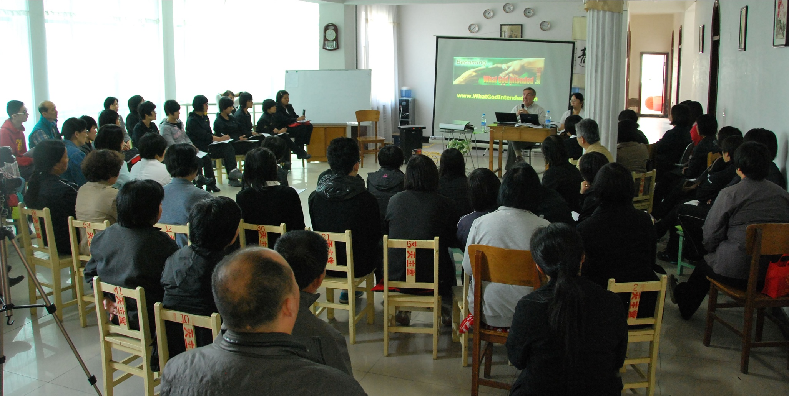
Day 1 Training on the Trinity.
From nine o'clock in the morning to nine o'clock at night, they listened attentively and with great pleasure to Dr. Eckman’s teaching.

Slide 16
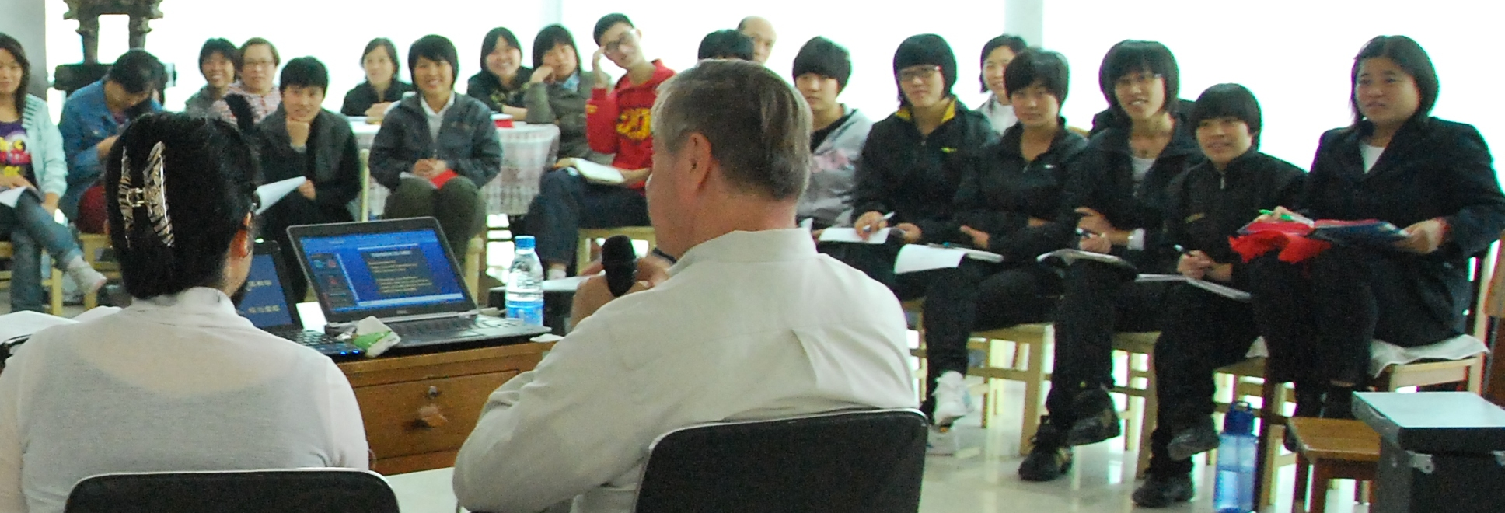
Exploring the Truths of
the Trinity

Slide 17
Father父
Son子
Spirit靈
God is One 一 神

Slide 18
YAHWEH IS ONE耶和華是一!
Deuteronomy 申命記 6:4
Hear, O Israel! Yahweh is our God, Yahweh is One! 以色列啊，你要聽！耶和華是我們的神，耶和华是一！
5 Therefore, you shall love Yahweh, your God, with all your heart, and with all your soul, and with all your strength. 所以，你要盡心、盡性、盡力愛耶和華─你的神。

Slide 19
Jesus and the Father Are One 耶稣与父是一!
John 10:28 “I give them eternal life, and they shall never perish. No one can take them out of my hand. 我又賜給他們永生；他們永不滅亡，誰也不能從我手裡把他們奪去。
29 My Father, who has given them to me, is greater than all, and no one can take them out of the Father's hand. 我父把羊賜給我，他比萬有都大，誰也不能從我父手裡把他們奪去。
30 The Father and I are One Thing.“我與父為一。

Slide 20
John約翰福音 3:16
For thus the God has displayed a delighted passion for the world in that He gave His only begotten Son with the result that each and every believer should not perish but have eternal life.
神已经显明了他对世人的爱（AGAPE），甚至将他的独生子赐给他们，叫一切信他的人不致灭亡、反得永生。

Slide 21
Principle
When Deity acts, the act is always by a particular Member of the Trinity!
但凡神行事，
必然是父、子、靈中
某一位格的行動！

Slide 22
FATHER 父
CHOOSES 揀選
HOLY 聖靈SPIRIT
SON子
SAVES 拯救
SALVATION
APPLIES 實施

Slide 23
John約翰福音6:37 "All that the Father gives Me shall come to Me, and the one who comes to Me I will certainly not cast out.”凡父所賜給我的人必到我這裡來；到我這裡來的，我總不丟棄他。
John約翰福音6:44 "No one can come to Me, unless the Father who sent Me draws him; and I will raise him up on the last day.”若不是差我來的父吸引人，就沒有能到我這裡來的；到我這裡來的，在末日我要叫他復活。

Slide 24
John約翰福音14:16-17
And I will pray the Father, and he shall give you another Comforter, that he may abide with you for ever; Even the Spirit of truth; whom the world cannot receive, because it sees him not, neither knows him: but ye know him; for he dwells with you, and shall be in you.
我要求父，父就另外賜給你們一位保惠師（counselor 顧問），叫他永遠與你們同在，就是真理的聖靈，乃世人不能接受的；因為不見他，也不認識他。你們卻認識他，因他常與你們同在，也要在你們裡面。

Slide 25
FATHER 父
GIVES 賜RESULTS 果效
HOLY 聖靈SPIRIT
SON子
GIVES 賜MINISTRY職事
SERVICE
GIVES GIFT 賜能力

Slide 26
1 Corinthians林前 12:4-6
4 Now there are varieties of gifts, but the same Spirit.恩賜（gifts）原有分別，聖靈卻是一位。
5 And there are varieties of ministries, and the same Lord. 職事（services）也有分別，主卻是一位。
6 And there are varieties of effects, but the same God who works all things in all. 能力果效（effect operations）也有分別，神卻是一位，在眾人裡面運行一切的事。

Slide 27
FATHER 父
DECIDES 決定
HOLY聖靈 SPIRIT
SON子
CREATES 創造
CREATION
SUSTAINS 維持照管

Slide 28
1 Corinthians 林前8:6
yet for us there is but one God, the Father, from whom are all things, and we for Him; and one Lord, Jesus Christ, by whom are all things, and we through Him.
然而我們只有一位神，就是父，萬物都本於他；我們也歸於他─並有一位主（耶和华），就是耶穌基督─萬物都是藉著他有的；我們也是藉著他有的。

Slide 29
Isaiah以賽亞書40:12-13
誰曾用手心量諸水，用手虎口量蒼天， Who hath measured the waters in the hollow of his hand, and meted out heaven with the span, …
誰曾指示耶和華的靈，或作他的謀士指教他呢？ Who hath directed the Spirit of the LORD, or being his counselor hath taught him?

Slide 30
FATHER 父
FOCUS 焦點
HOLY 聖靈SPIRIT
SON子
HIGH PRIEST 大祭司
PRAYER
CHANGES 改變

Slide 31
John約翰福音 4:23
"But an hour is coming, and now is, when the true worshipers shall worship the Father in spirit and truth; for such people the Father seeks to be His worshipers.” 時候將到，如今就是了，那真正拜父的，要在圣靈和真理中拜他，因為父寻找這樣的人拜他。

Slide 32
FATHER 父
LOVES US 愛我們
HOLY聖靈 SPIRIT
SON子
THE CROSS
LOVES FATHER 愛父
GIVES SENSE OF LOVE 讓我們 感受到愛

Slide 33
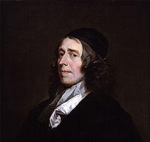
John Owen, Communion with the Triune God 與三一神契通 1657
2 Corinthians 13:14 The grace of the Lord Jesus Christ, and the love of God, and the fellowship of the Holy Spirit, be with you all.願主耶穌基督的恩惠、神的慈愛、聖靈的感動（fellowship），常與你們眾人同在！
Ascribing sundry things unto the distinct Persons, it is love that he peculiarly assigns to the Father. 各样美言归给神的不同位格，而保罗特别归给父神的是爱。 Page 108

Slide 34
John 約翰14:31 “but that the world may know that I love the Father, and as the Father gave Me commandment, even so I do. Arise, let us go from here.”人若愛我，就必遵守我的道；我父也必愛他，並且我們要到他那裡去，與他同住。…但要叫世人知道我愛父，並且父怎樣吩咐我，我就怎樣行。
John 13:1 Now before the Feast of the Passover, Jesus knowing that His hour had come that He should depart out of this world to the Father, having loved His own who were in the world, He loved them to the end.逾越節以前，耶穌知道自己離世歸父的時候到了。他既然愛世間屬自己的人，就愛他們到底。

Slide 35
FATHER 父
Satisfied 滿意
HOLY 聖靈 SPIRIT
SON子
Our Sin
Propitiates 使父滿意
Pained 嘆息

Slide 36
Revelation 5:6 And I saw between the throne (with the four living creatures) and the elders a Lamb permanently standing, like one having been slain,我又看見寶座（與四活物）与長老之间有羔羊站立，像是被殺過的，
Ephesians 4:30 And all of you stop paining the Holy Spirit of God, by whom you were sealed for the day of redemption.不要叫神的聖靈擔憂；你們原是受了他的印記，等候得贖的日子來到。

Slide 37
FATHER 父
Child-Trains 管教
HOLY 聖靈SPIRIT
SON 子
Our Sin 我們的罪
Judges 審判
Withholds 抑制果子

Slide 38
Hebrews 12:7 It is for child-training that you endure; God deals with you as sons; for what son is there whom a father does not child-train?你們所忍受的，是神管教你們，待你們如同待兒子。焉有兒子不被父親管教的呢？
Revelation 3:19 'Those whom I like, I reprove and child-train; be zealous therefore, and have a profound change of heart.”凡我所疼愛的，我就責備管教他；所以你要發熱心，也要悔改。

Slide 39
John約翰福音5:22-27
the Father judges no man, but has committed all judgment unto the Son，… And has given him authority to execute judgment also, because he is the Son of man.
父不審判甚麼人，乃將審判的事全交與子，… 並且因為他是人子，就賜給他行審判的權柄。

Slide 40
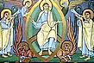
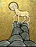
The Great Appreciator 偉大欣賞
HOLY 聖靈SPIRIT

Slide 41
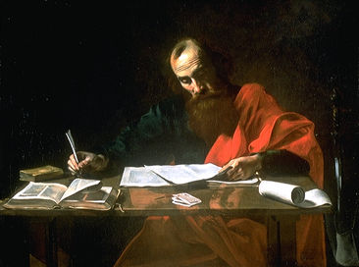
The Father wants Daughters and Sons John 17
:23 I in them, and You in Me, that they may be brought to completion in one, that the world may know that You sent Me, and You have loved them, even as You have loved Me.我在他們裡面，你在我裡面，使他們完完全全的合而為一，叫世人知道你差了我來，也知道你愛他們如同愛我一樣。
:24 "Father, I desire that they also, whom You have given Me, be with Me where I am, in order that they may behold My glory, which You have given Me; for You have loved Me before the foundation of the world.
父啊，我在那裡，願你所賜給我的人也同我在那裡，叫他們看見你所賜給我的榮耀；因為創立世界以前，你已經愛我了。

Slide 42
Relational
注重關係的神
Ontological本體存在的神
ONENESS
神是一

Slide 43
Principles 定律
  The Uniqueness of the Father.
  獨特的聖天父
  The Cooperative Trinity
  同心協作的父、子、靈
  No Generic God
  不是無標簽的神
  Anything Deity does, is done by a particular Member of the Trinit
  但凡神行事，必然是父、子、灵中某一位格的行动

